Slide 1
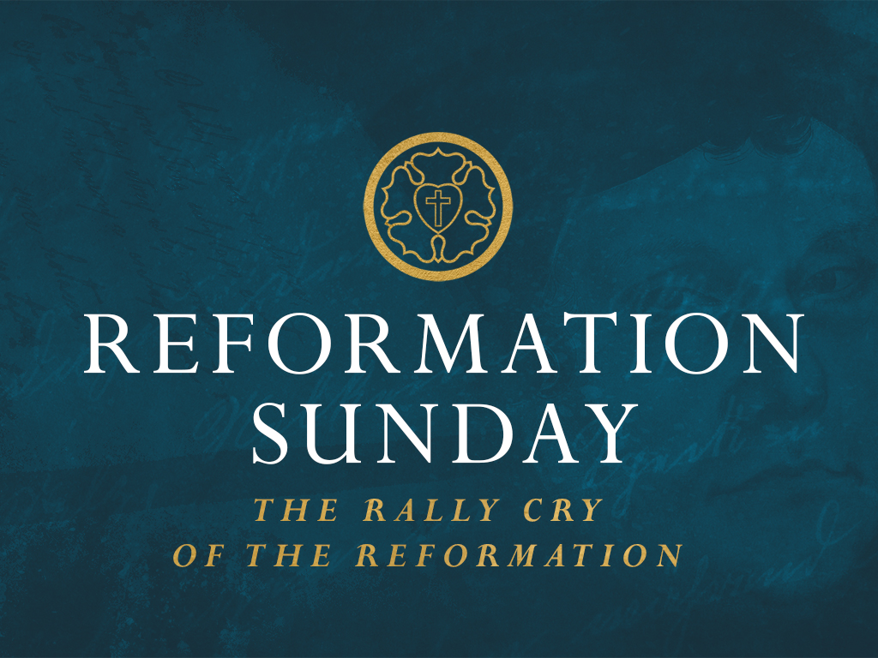

Slide 2

Romans 1
¹⁶For I am not ashamed of the gospel, for it is the power of God for salvation to everyone who believes, to the Jew first and also to the Greek. ¹⁷ For in it the righteousness of God is revealed from faith for faith, as it is written, “The righteous shall live by faith.” (ESV)

Slide 3
Reformation
A religious movement of the 1500’s that began as an attempt to reform the Roman Catholic Church and resulted in the creation of the Protestant Church.

Slide 4
Roman Catholic Church
The Catholic Church has been defined as a union of human beings who are united by the profession of the same Christian faith, and by participation of and in the same sacraments under the direction of their lawful pastors, especially of the one representative of Christ on earth, the Bishop of Rome. Each element in this definition is meant to exclude all others from actual and vital membership in the Catholic Church, namely apostates and heretics who do not profess the same Christian faith, non-Christians who do not receive the same sacraments, and schismatics who are not submissive to the Church's lawful pastors under the Bishop of Rome.
The Council of Trent

Slide 5
Purgatory
"All who die in God's grace and friendship, but still imperfectly purified, are indeed assured of their eternal salvation; but after death they undergo purification, so as to achieve the holiness necessary to enter the joy of heaven. The Church gives the name purgatory to this final purification of the elect, which is entirely different from the punishment of the damned" (CCC 1030-1).

Slide 6
Indulgences
“A remission before God of temporal punishment for sins, whose guilt is forgiven, which a properly disposed member of the Christian faith obtains under certain and clearly defined conditions through the intervention of the Church.” -Manuel of Indulgences

Slide 7
Key Reformers
John Wycliffe (1320’s to 1384)
John Huss (1369-1415)
Martin Luther (1483-1546)
Ulrich Zwingli (1484-1531)
William Tyndale (England)
John Calvin (France)
John Knox (Scotland)

Slide 8
1. The Stirring of the Volcano
"If anyone could have earned heaven by the life of a monk, it was I."
Martin Luther

Slide 9
Romans 1
¹⁶For I am not ashamed of the gospel, for it is the power of God for salvation to everyone who believes, to the Jew first and also to the Greek. ¹⁷ For in it the righteousness of God is revealed from faith for faith, as it is written, “The righteous shall live by faith.” (ESV)

Slide 10
1. The Stirring of the Volcano
"At last meditating day and night, by the mercy of God, I ... began to understand that the righteousness of God is that through which the righteous live by a gift of God, namely by faith… Here I felt as if I were entirely born again and had entered paradise itself through the gates that had been flung open."

Slide 11
2. The Eruption
‘You should know that all who confess and in penance put alms into the coffer according to the counsel of the confessor, will obtain complete remission of all their sins.’
John Tetzel

Slide 12
2. The Eruption
‘Don't you hear the voices of your wailing dead parents and others who say, 'Have mercy upon me, have mercy upon me, because we are in severe punishment and pain. From this you could redeem us with a small alms and yet you do not want to do so.' Open your ears as the father says to the son and the mother to the daughter,… John Tetzel

Slide 13
2. The Eruption
'We have created you, fed you, cared for you, and left you our temporal goods. Why then are you so cruel and harsh that you do not want to save us, though it only takes a little? You let us lie in flames so that we only slowly come to the promised glory.'
John Tetzel

Slide 14
2. The Eruption
“Every time a coin in the coffer rings, a soul from purgatory springs.”
John Tetzel

Slide 15
2. The Eruption
Thesis 28: The love of God does not find, but creates, that which is pleasing to it. The love of man comes into being through that which is pleasing to it.
The Heidelberg Disputation
Martin Luther

Slide 16
2. The Eruption
We love because he first loved us.
1 John 4:19

Slide 17
2. The Eruption
Since your most serene majesty and your Lordships require of me a simple, clear, and direct answer, I will give one, and it is this: I cannot submit my faith either to the pope or to the council, because it is as clear as noonday that they have fallen into error and even into glaring inconsistency with themselves.

Slide 18
2. The Eruption
If, then, I am not convinced by proof from Holy Scripture, or by cogent reasons, if I am not satisfied by the very text I have cited, and if my judgment is not in this way brought into subjection to God’s word,…

Slide 19
2. The Eruption
I neither can nor will retract anything; for it cannot be either safe or honest for a Christian to speak against his conscience. Here I stand; I cannot do otherwise; God help me! Amen.
Martin Luther
Diet (Assembly) of Worms

Slide 20
3. The Results of the Eruption
The Five “Solas”
The Rally Cry of the Reformation
Sola Scriptura (Scripture Alone)
Sola Gratia (Grace Alone)
Solus Christus (Christ Alone)
Sola Fide (Faith Alone)
Soli Deo Gloria (To the Glory of God Alone)

Slide 21

Here I stand;
I cannot do otherwise; God help me! Amen.

